Slide 1




Paul Michaels
@paul_michaels
https://www.linkedin.com/in/pcmichaels/
https://www.pmichaels.net/
https://github.com/pcmichaels

Slide 2
What are ADRs anyway?
An Inexhaustive Guide
Notes:
This is an introduction, not an exhaustive explanation. Also, as with anything, use what works for you – not something that someone has told you – however enigmatic they may be. Although this talk has a .Net flavour, there’s nothing that is .Net specific per se

Slide 3


Architecture Decision Record
Think About Your Ideas
Record your thoughts
Notes:
Forces you to think about the decisions that you make and record them

Slide 4
The When, What, Why and How…
Not necessarily in that order

Slide 5
When should you create an ADR?
Any decision that is Architecturally Significant
The Choice of ORM
Deciding to use an API, or an Azure Function
The decision to use a specific testing framework, or a decision to adopt a testing strategy
Sometimes, this can be the decision to NOT do something
Notes:
When should you use ADRs?
What is Architecturally Significant – imagine that you’ve never seen your solution, you don’t know the business domain and you don’t understand the technology. Architecturally Significant is the part where you say: “but why have you done it like this?” The idea here is that you’re recording these reasons so that you don’t have a conversation in 6 months where you say: “we did have a reason for this – I just can’t remember what it was.”

Slide 6
Where should you keep your ADRs?
In your solution
Should be part of your source code
Visual Studio Screenshot…
Notes:
What is Architecturally Significant – imagine that you’ve never seen your solution, you don’t know the business domain and you don’t understand the technology. Architecturally Significant is the part where you say: “but why have you done it like this?”

Slide 7
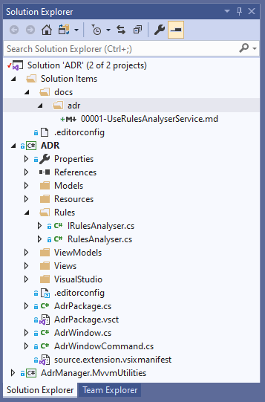

Slide 8
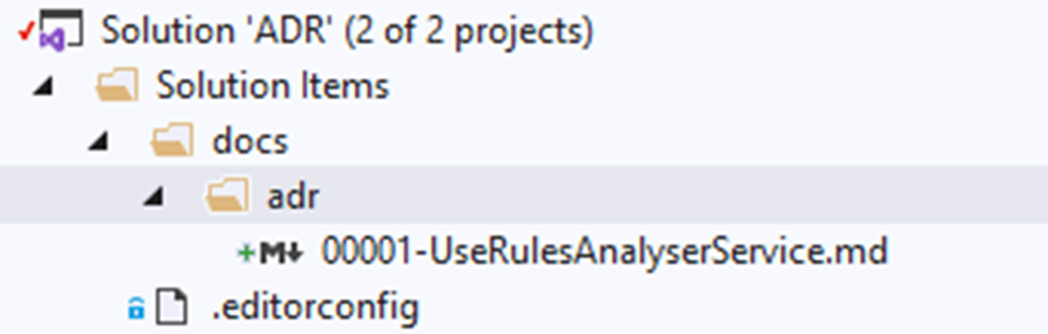

Slide 9
What is an ADR - exactly?
Anything that can be viewed with the tools that you normally write code with
Markdown
Plain Text
Don’t put word documents in your repo
Let’s see a sample template…
Notes:
Word docs, excel, powerpoint, etc – require a third party tool to view them

Slide 10
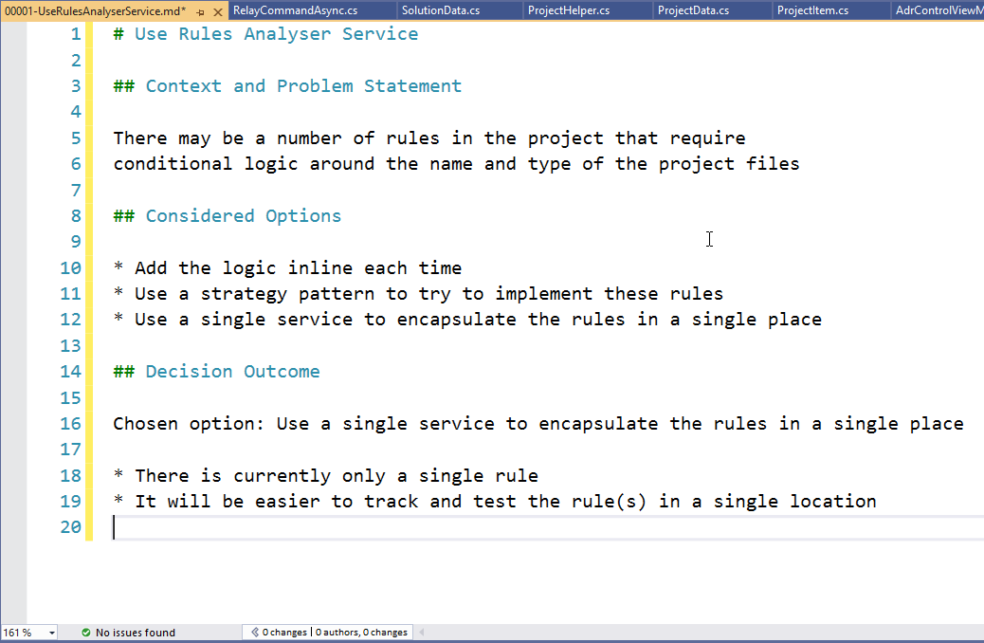

Slide 11

Thank you
https://github.com/pcmichaels/ADRManager

